Slide 1

Update on GGOS Africa
The Global Geodetic Observing System: Africa
Aslam Parker | Aletha de Witt
South African National Geodesy Workshop 2026 | 30 September – 02 October 2026 | DLRRD, Pretoria
Notes:
Title slide. Replace title, subtitle, presenter and event details.

Slide 2
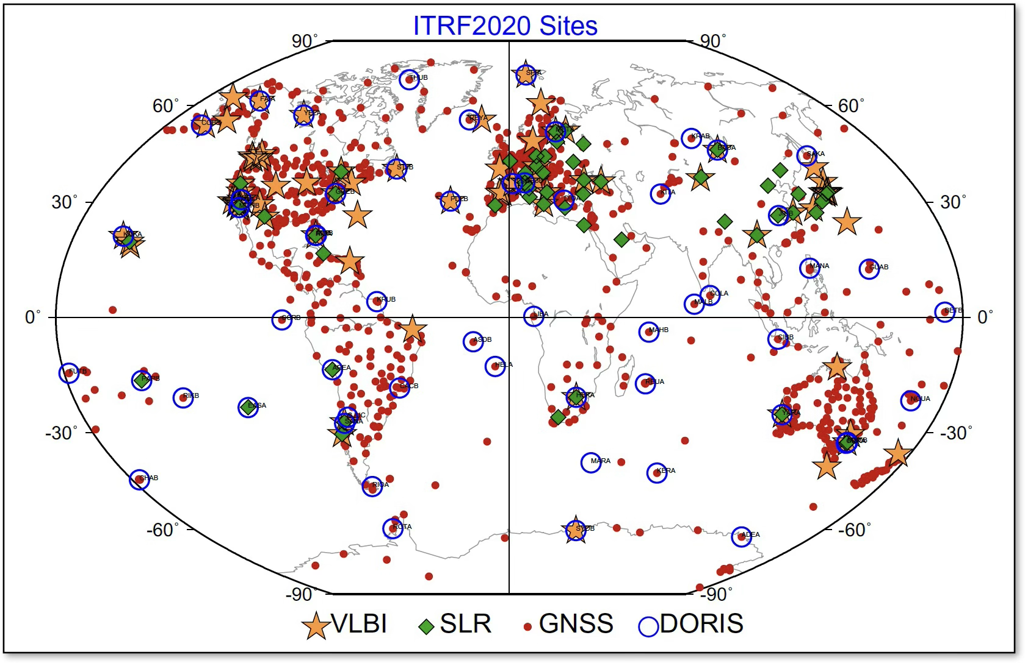
Current Geodetic Landscape in Africa
South African Geodesy Working Group
Notes:
Standard content layout. Delete the panel if you need full width for the text.

Slide 3
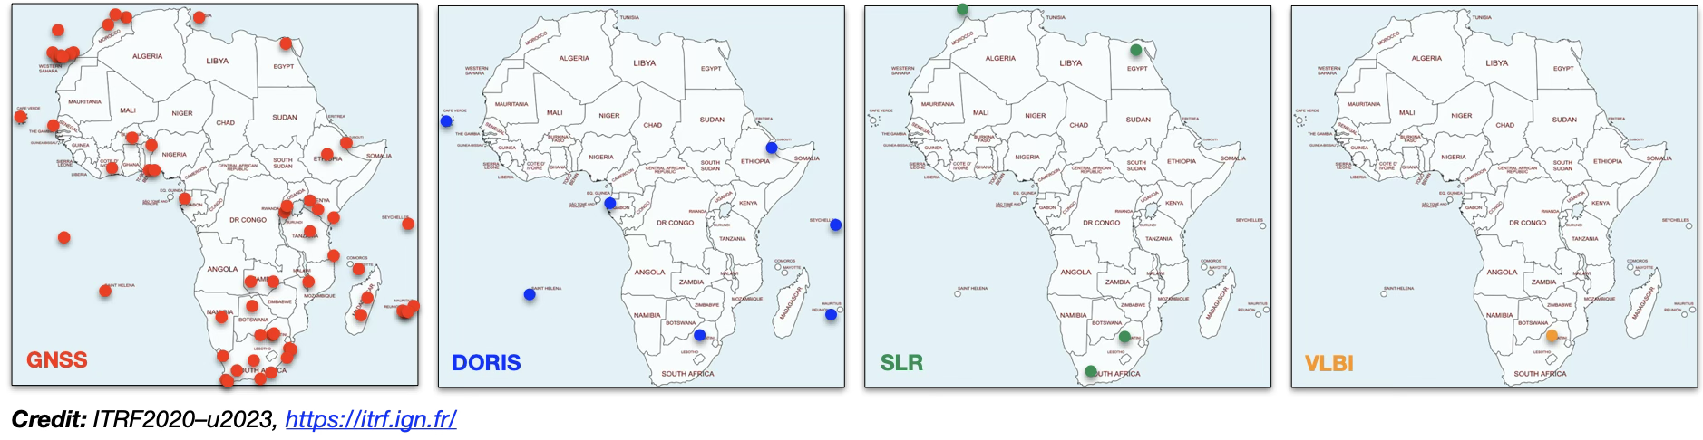
Current Geodetic Landscape in Africa
South African Geodesy Working Group
Notes:
Standard content layout. Delete the panel if you need full width for the text.

Slide 4
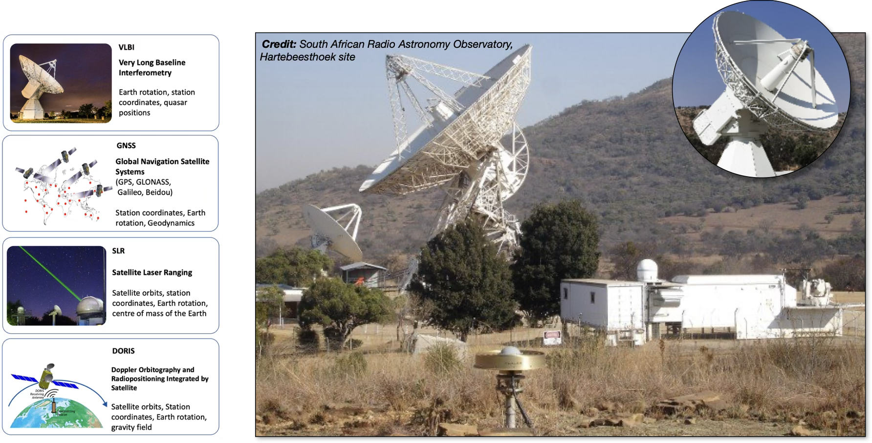
GGOS Core Sites: only one in Africa!
South African Geodesy Working Group
Notes:
Standard content layout. Delete the panel if you need full width for the text.

Slide 5
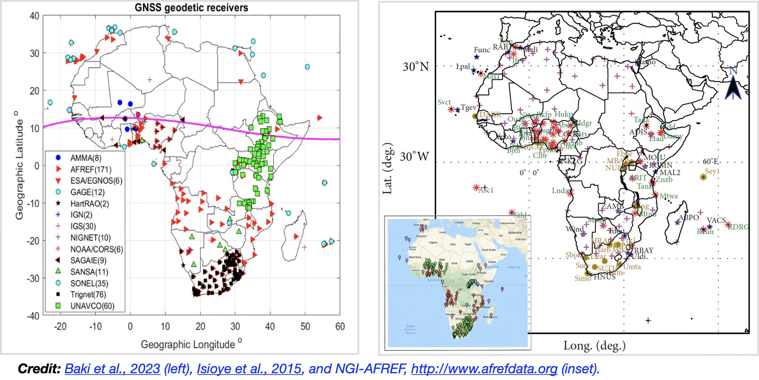
"What appears to exist" vs "What actually contributes"
South African Geodesy Working Group
Notes:
Standard content layout. Delete the panel if you need full width for the text.

Slide 6
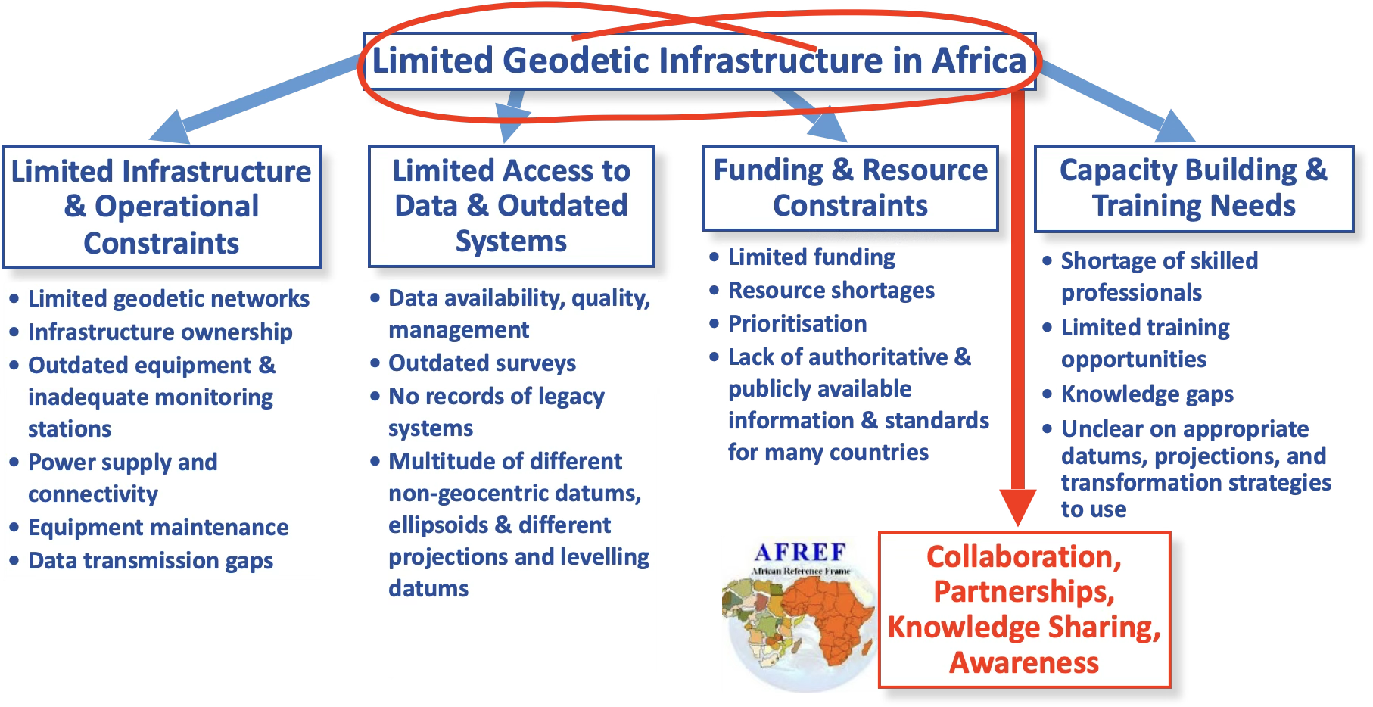
Challenges in Geodesy in Africa
South African Geodesy Working Group
Notes:
Standard content layout. Delete the panel if you need full width for the text.

Slide 7
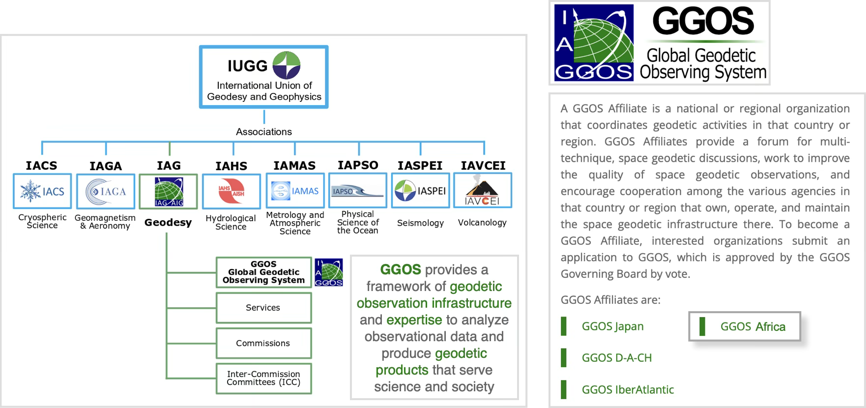
What is GGOS Africa?
South African Geodesy Working Group
Notes:
Standard content layout. Delete the panel if you need full width for the text.

Slide 8
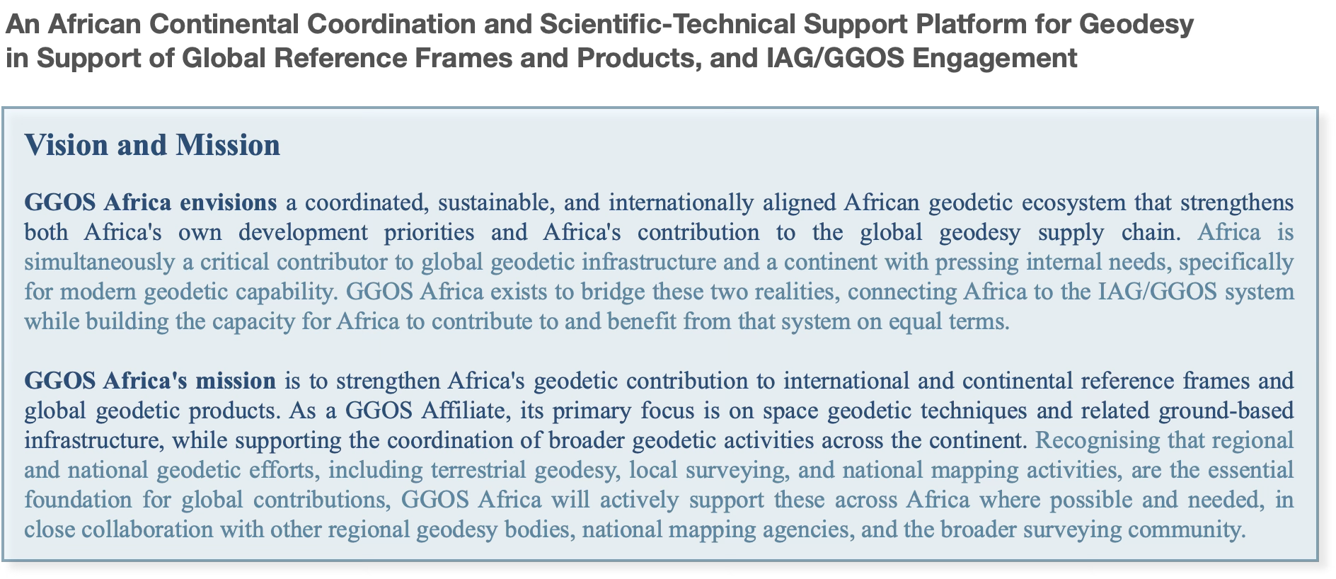
What is GGOS Africa?
South African Geodesy Working Group
Notes:
Standard content layout. Delete the panel if you need full width for the text.

Slide 9
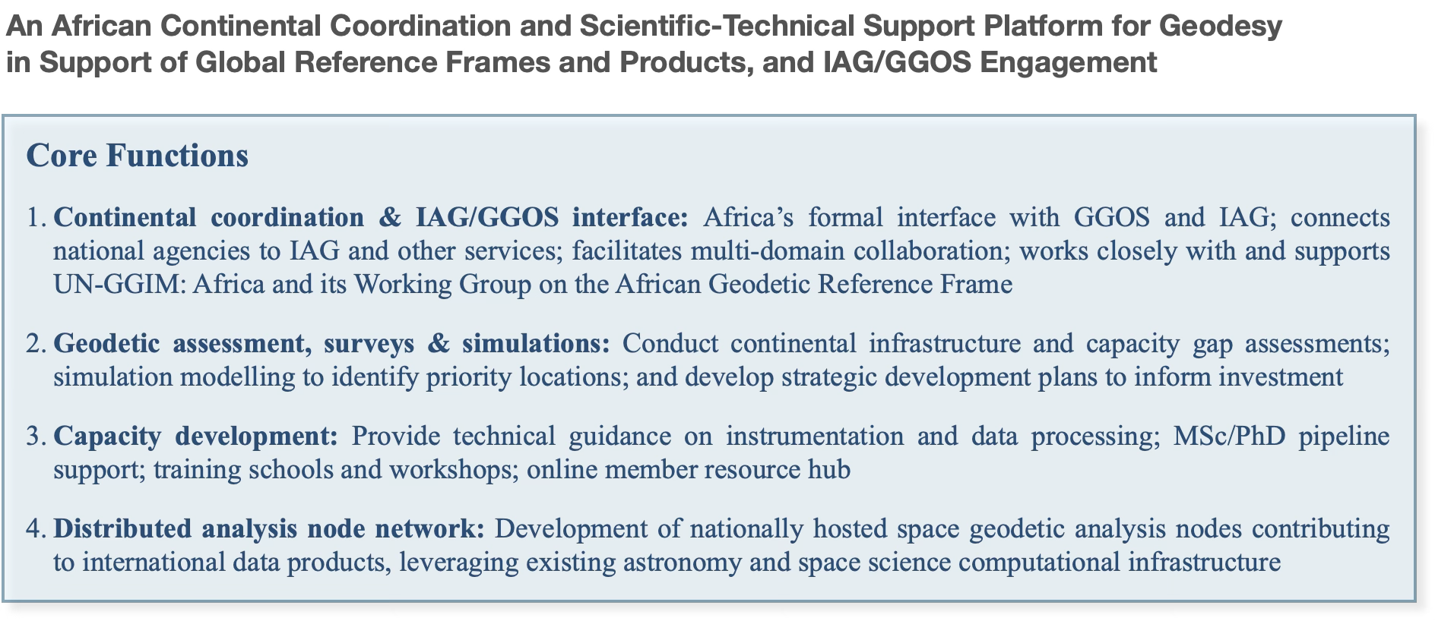
What is GGOS Africa?
South African Geodesy Working Group
Notes:
Standard content layout. Delete the panel if you need full width for the text.

Slide 10
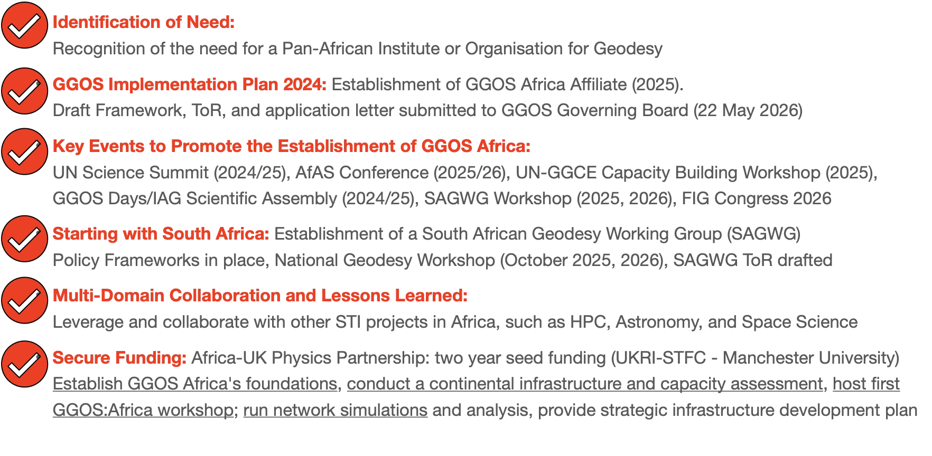
GGOS Africa: Progress to Date
South African Geodesy Working Group
Notes:
Standard content layout. Delete the panel if you need full width for the text.

Slide 11
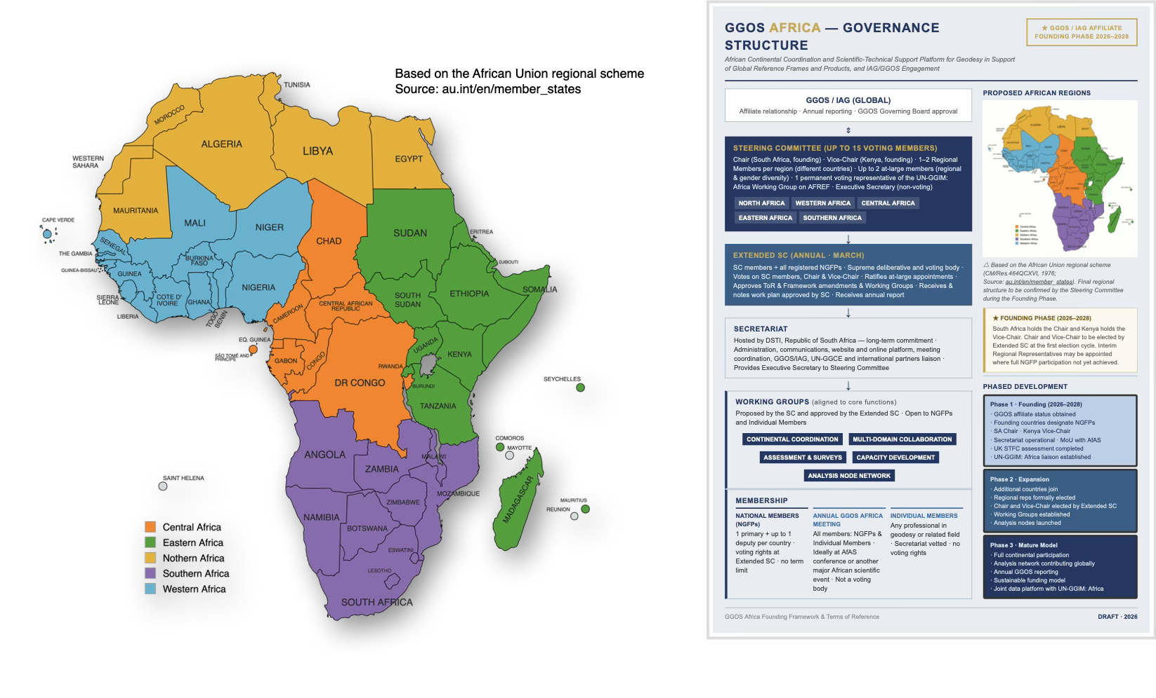
GGOS Africa: Foundations
South African Geodesy Working Group
Notes:
Standard content layout. Delete the panel if you need full width for the text.

Slide 12

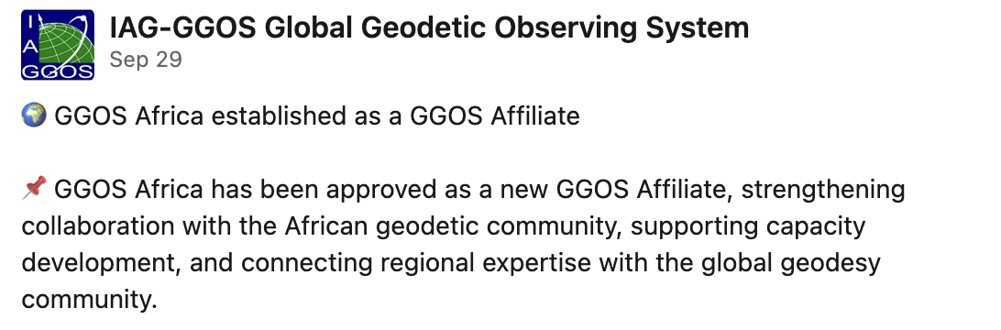
GGOS Africa: Progress to Date
South African Geodesy Working Group
Notes:
Standard content layout. Delete the panel if you need full width for the text.

Slide 13

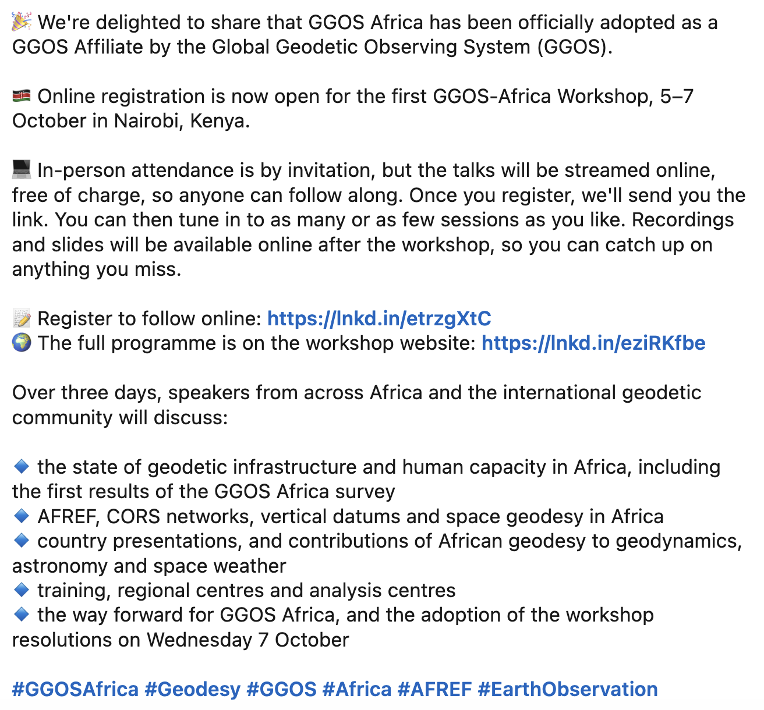
GGOS Africa: First Workshop
South African Geodesy Working Group
Notes:
Standard content layout. Delete the panel if you need full width for the text.

Slide 14
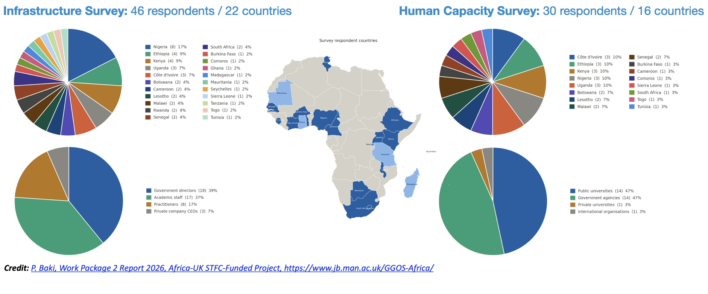
GGOS Africa: Infrastructure and Human Capacity Survey
South African Geodesy Working Group
Notes:
Standard content layout. Delete the panel if you need full width for the text.

Slide 15
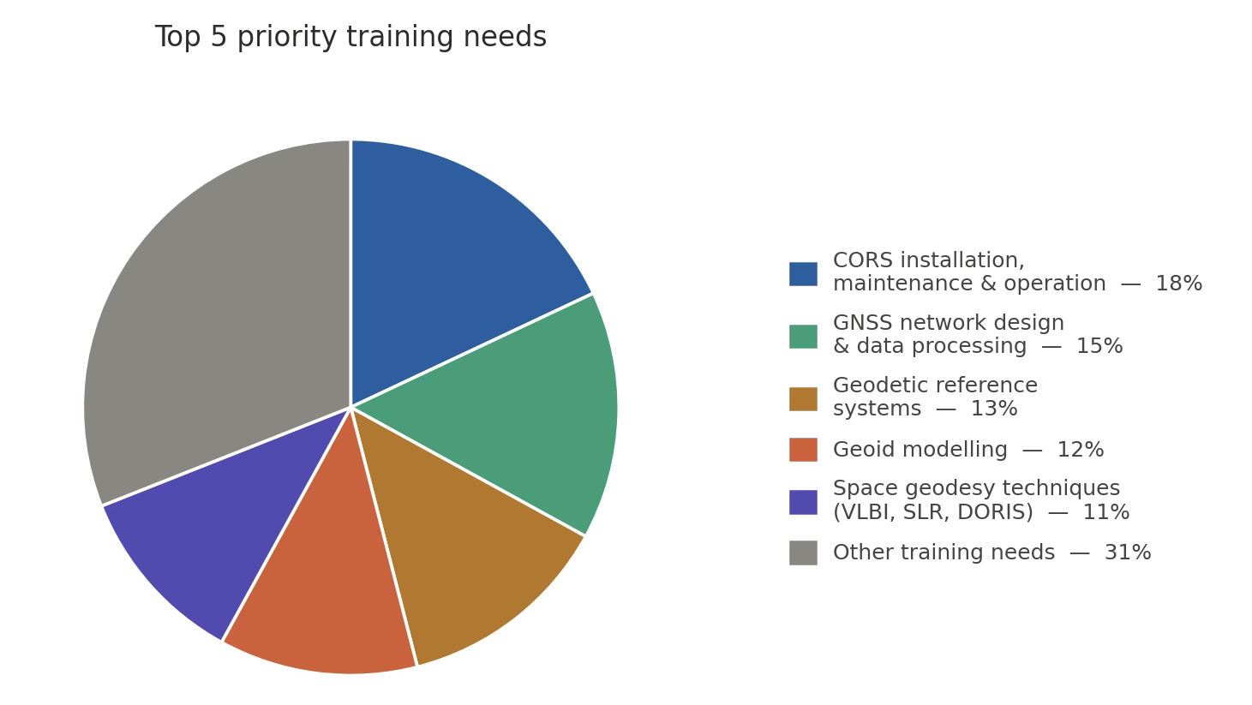
GGOS Africa: Infrastructure and Human Capacity Survey
South African Geodesy Working Group
Notes:
Standard content layout. Delete the panel if you need full width for the text.

Slide 16
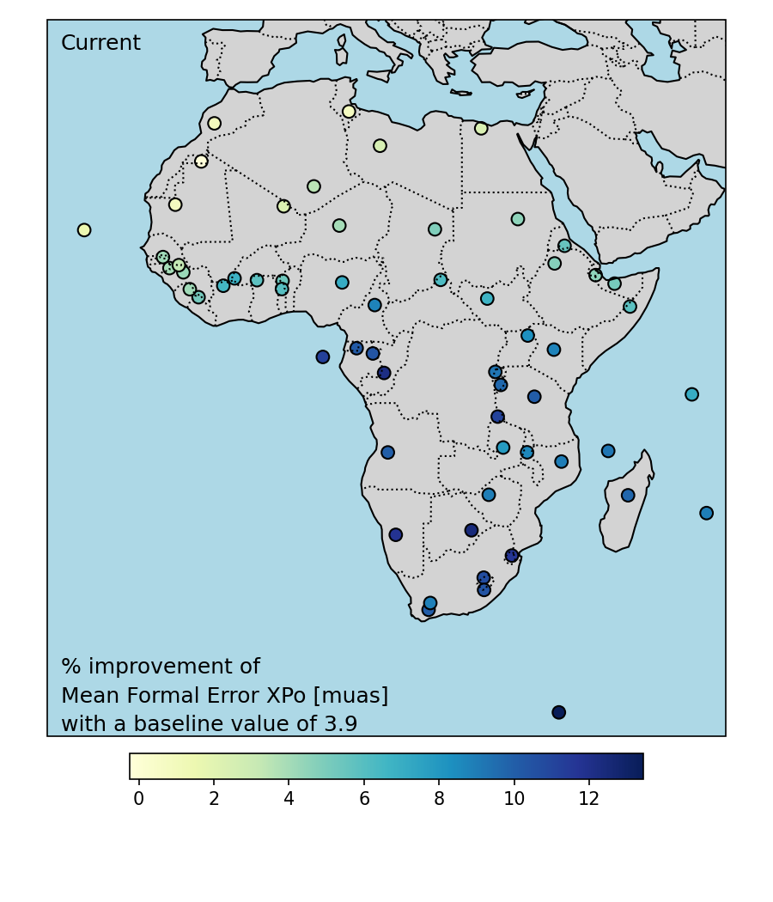
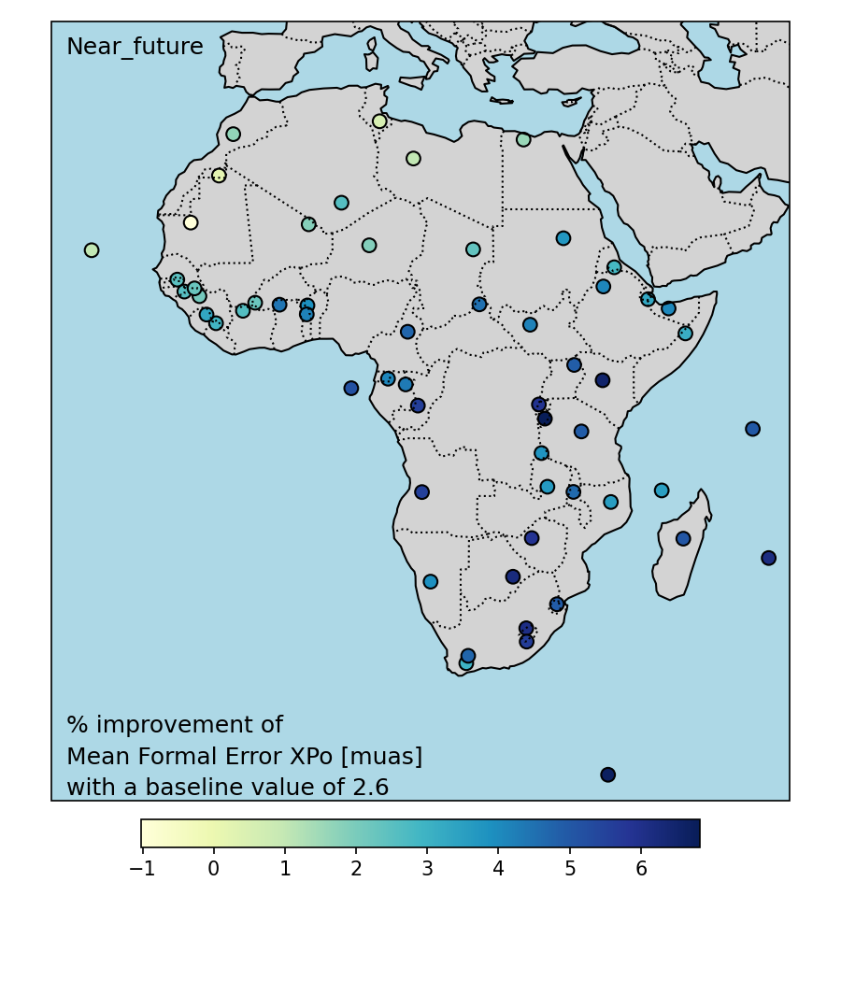

GGOS Africa: Network Simulations Underway
X-pole EOP improvement (% improvement of mean formal error)
Current VGOS sites, online soon, funded future sites (Credit: R. Botha using VieSched++)
Notes:
Standard content layout. Delete the panel if you need full width for the text.

Slide 17
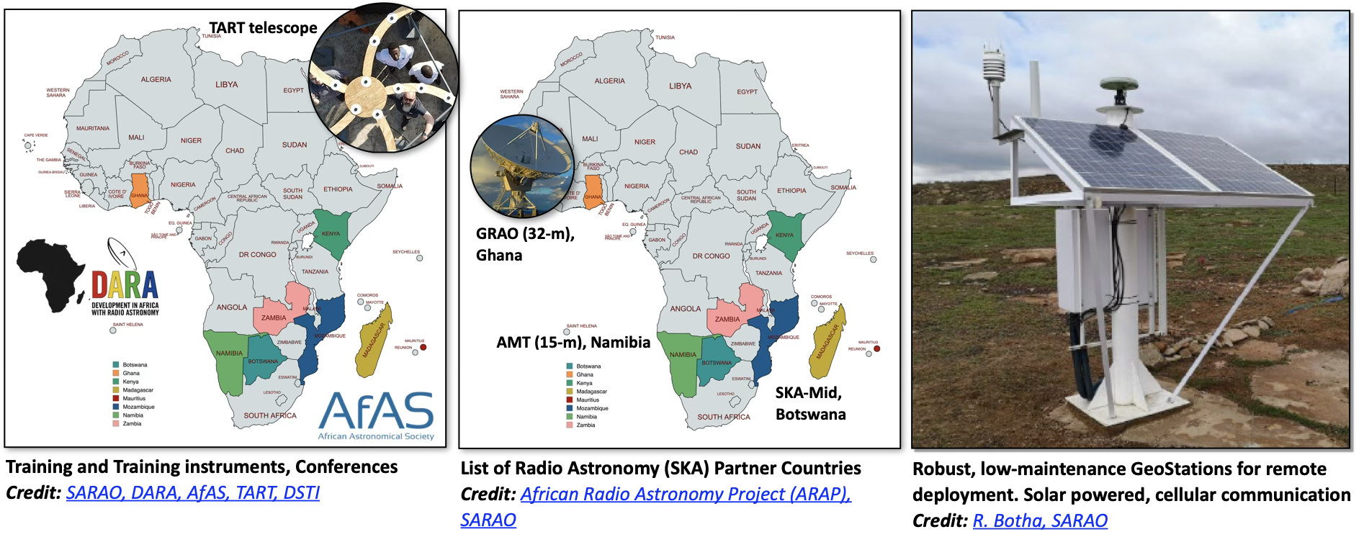
GGOS Africa: Multi-Domain Collaboration
Astronomy
South African Geodesy Working Group
Notes:
Standard content layout. Delete the panel if you need full width for the text.

Slide 18
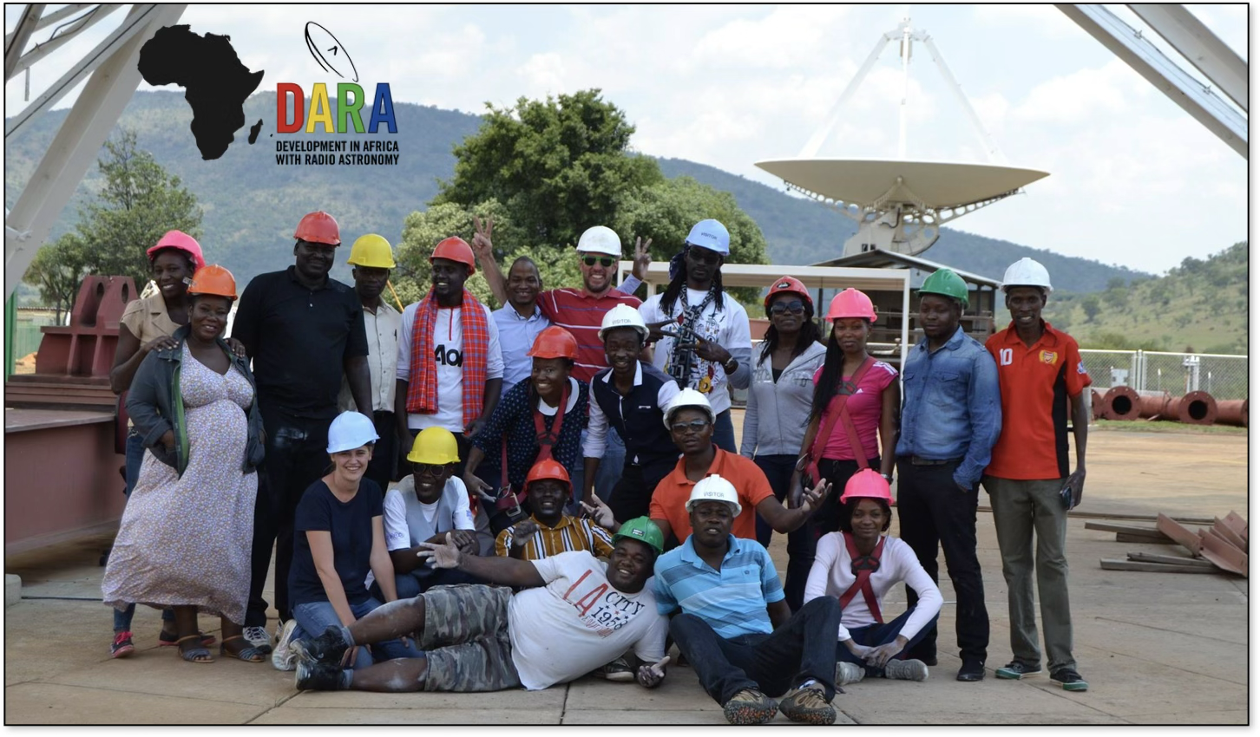
GGOS Africa: Multi-Domain Collaboration
South African Geodesy Working Group
Notes:
Standard content layout. Delete the panel if you need full width for the text.

Slide 19
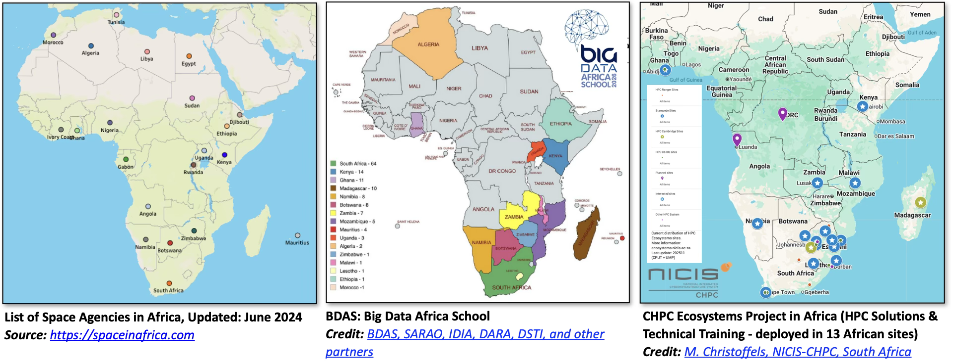
GGOS Africa: Multi-Domain Collaboration
Space Science Computational Infrastructure -> Analysis Centers
South African Geodesy Working Group
Notes:
Standard content layout. Delete the panel if you need full width for the text.

Slide 20

GGOS Africa – Now an Official GGOS Affiliate
Notes:
Pull-quote or key-message slide. Use sparingly, once or twice in a deck.

Slide 21
Thank you
Aletha de Witt
aletha.dewitt@dsti.gov.za
Notes:
Closing slide with contact details and partner logos.

