Slide 1

The International Celestial Reference Frame
and Earth Orientation Parameters
Why geodesy starts billions of light-years away
Aletha de Witt
South African National Geodesy Workshop 2026 | 30 September – 02 October 2026 | DLRRD, Pretoria
Notes:
Title slide. Replace title, subtitle, presenter and event details.

Slide 2
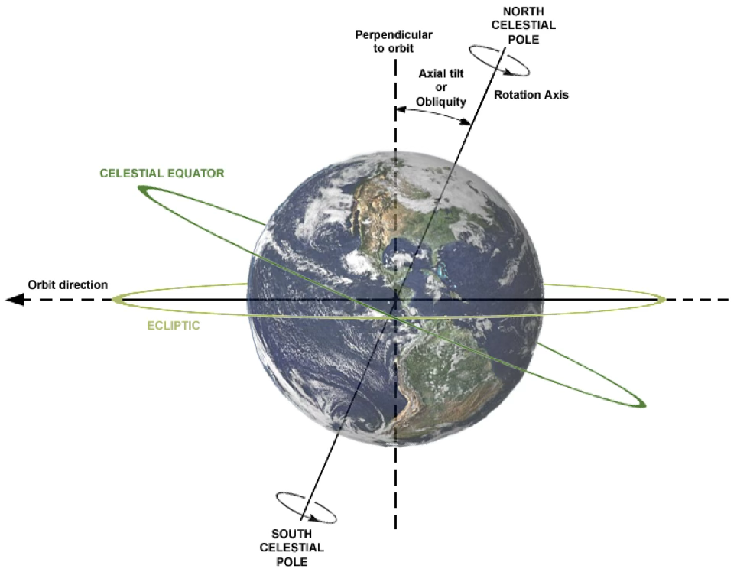
What is Geodesy?
Geodesy is the science of measuring the Earth’s dynamic shape, its gravity field, and its orientation and motion in space
South African Geodesy Working Group
Notes:
Standard content layout. Delete the panel if you need full width for the text.

Slide 3
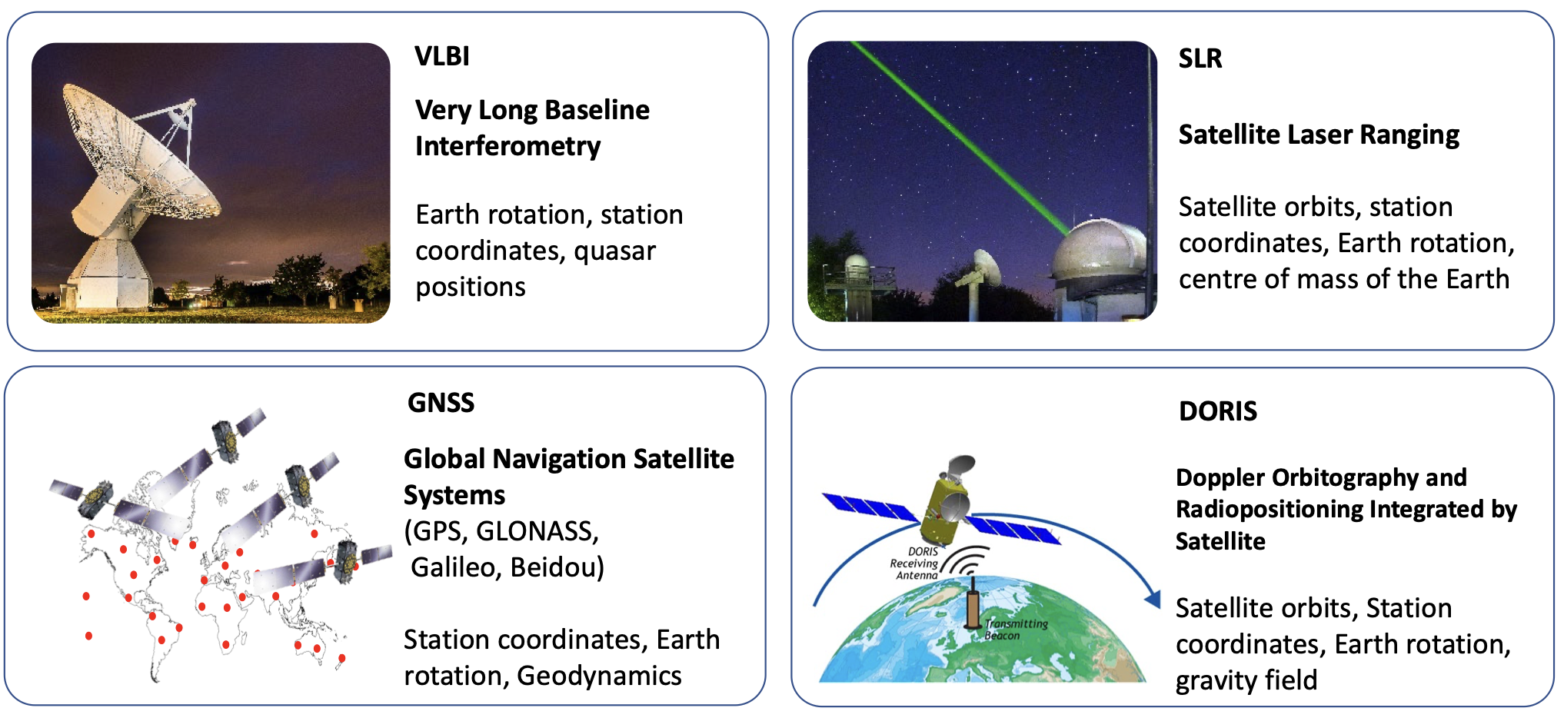
What is Geodesy?
Geodesy is the science of measuring the Earth’s dynamic shape, its gravity field, and its orientation and motion in space
(Space) geodesy
South African Geodesy Working Group
Notes:
Standard content layout. Delete the panel if you need full width for the text.

Slide 4


What is Geodesy?
Geodesy is the science of measuring the Earth’s dynamic shape, its gravity field, and its orientation and motion in space
(Space) geodesy
Parameter | VLBI | GNSS | DORIS | SLR
ICRF
Nutation
Polar motion
UT1
Length-of-day
Subdaily ERPs
ERP oceantide amplitudes
Coordinates/velocities (ITRF)
Geocentre
Gravitational field
Satellite orbits
LEO satellite orbits
Ionosphere
Troposphere
Time synchronisation
South African Geodesy Working Group
Notes:
Standard content layout. Delete the panel if you need full width for the text.

Slide 5
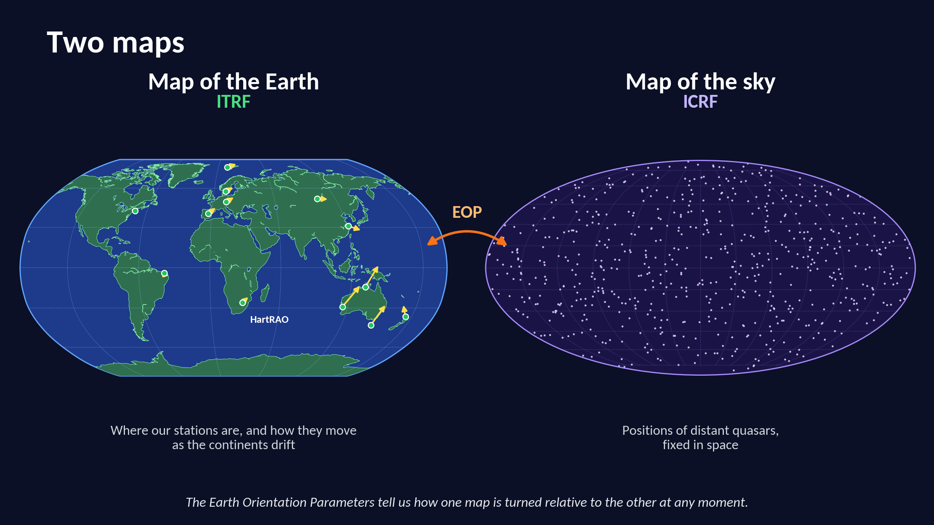
Overview of the 2025 Workshop
Notes:
Standard content layout. Delete the panel if you need full width for the text.

Slide 6
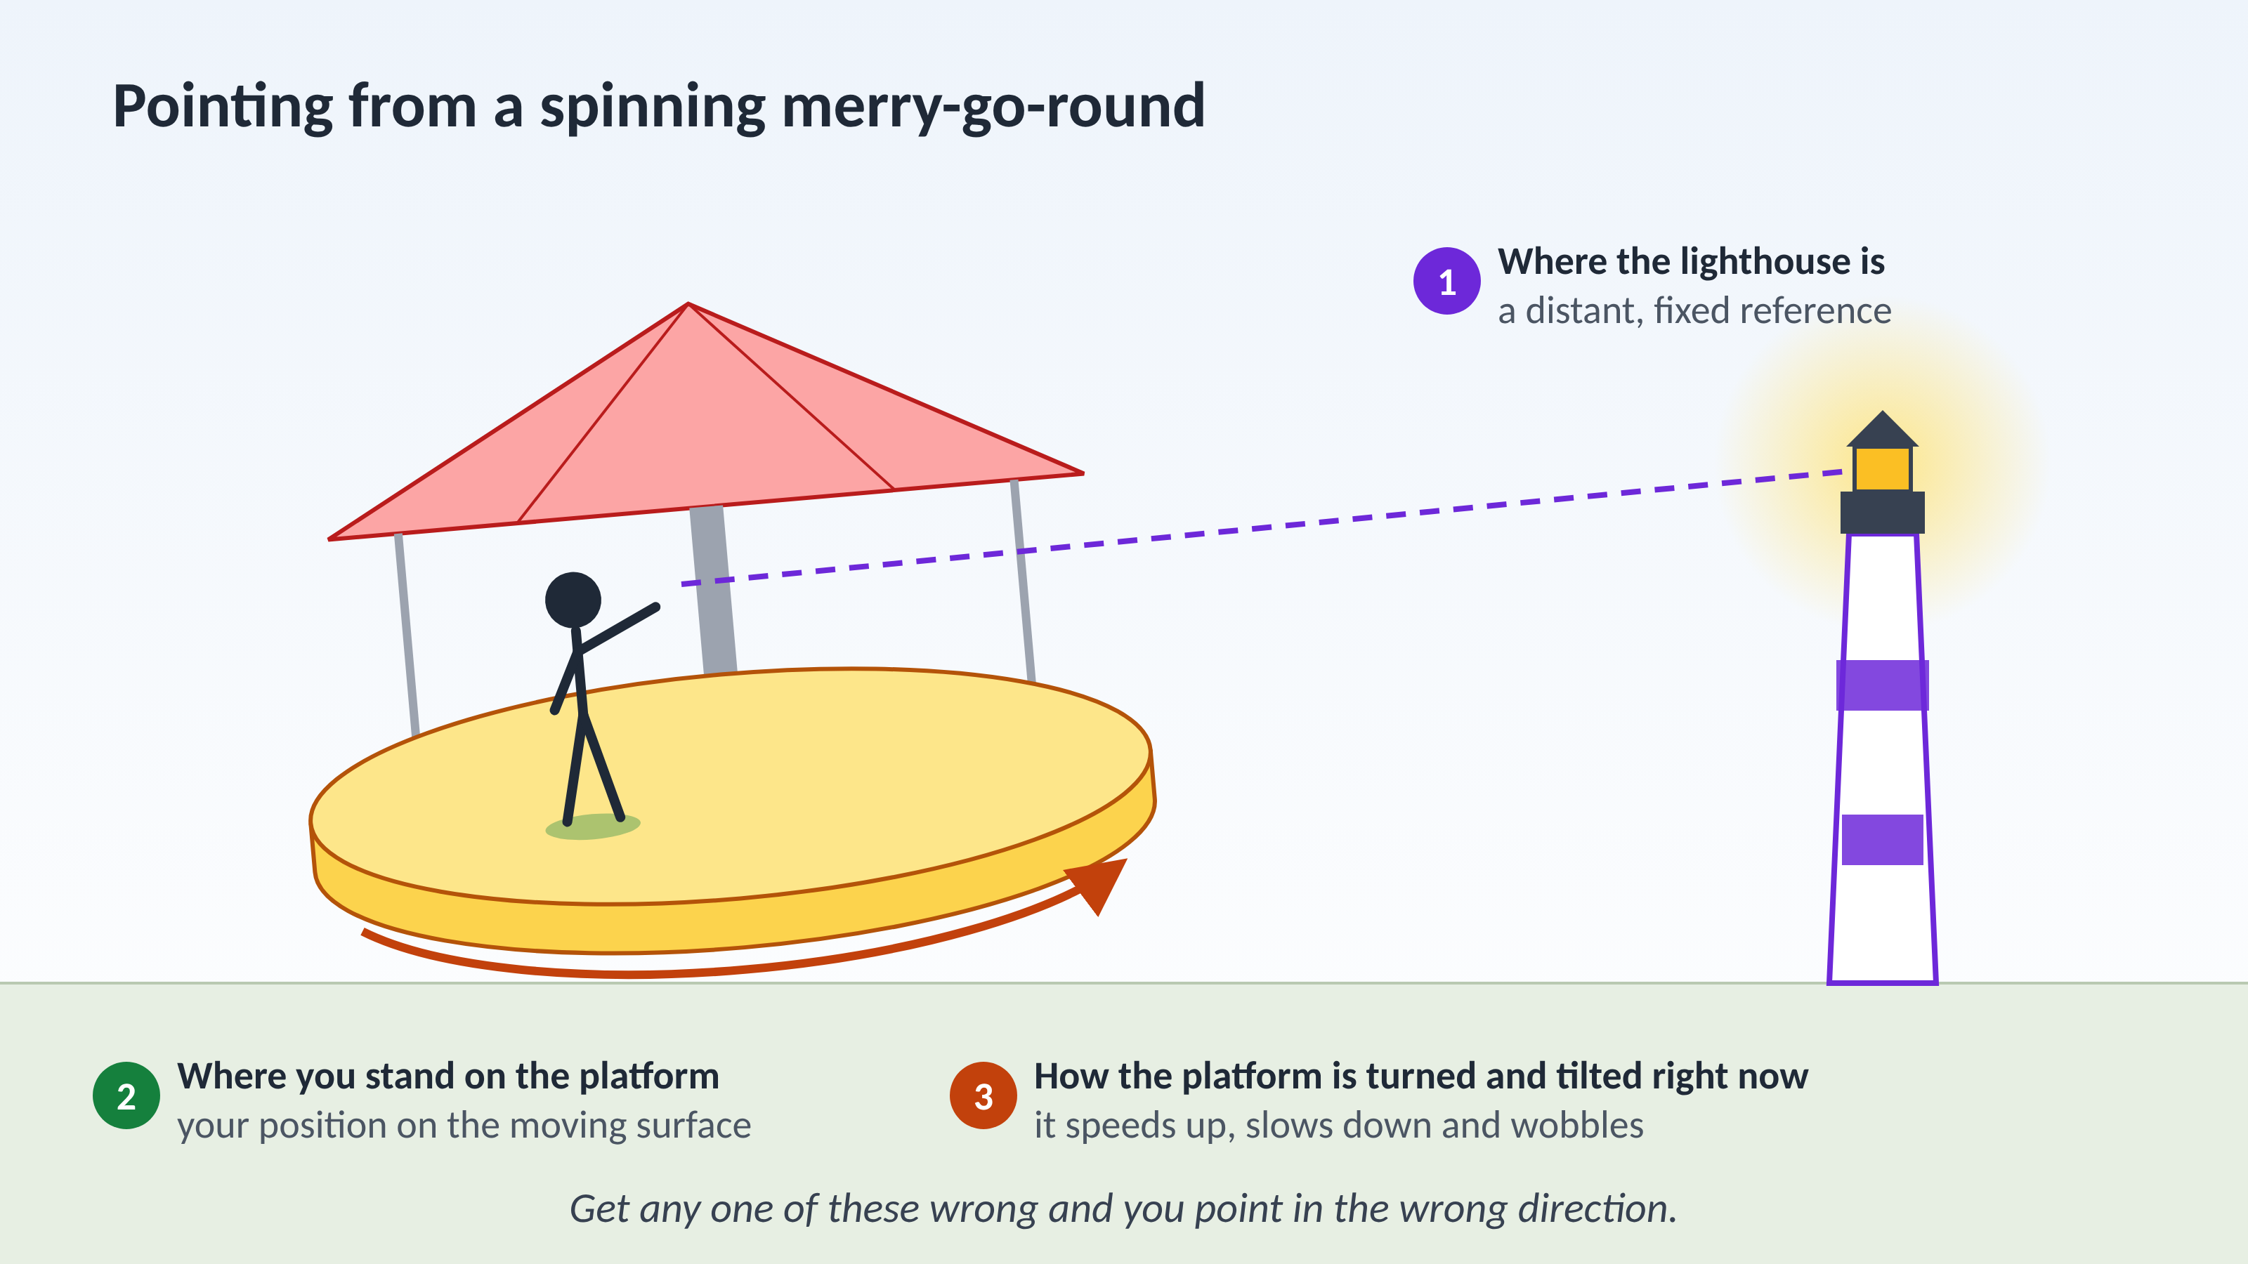
Overview of the 2025 Workshop
Notes:
Standard content layout. Delete the panel if you need full width for the text.

Slide 7
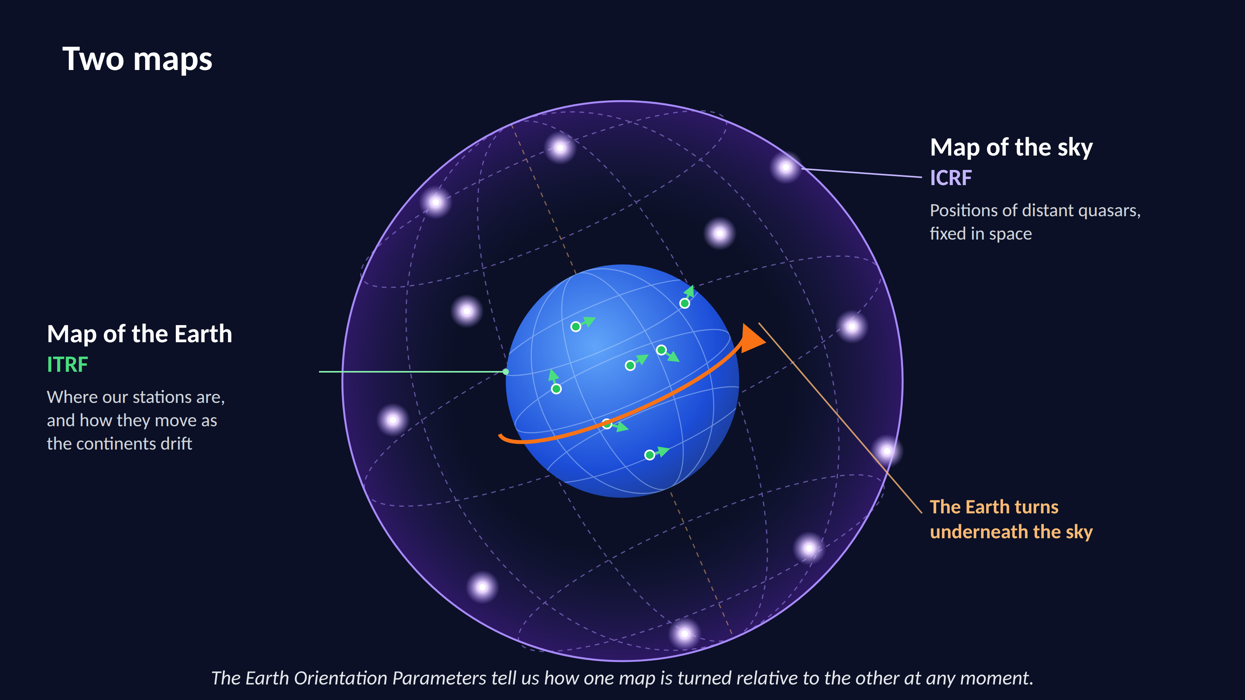
Overview of the 2025 Workshop
Notes:
Standard content layout. Delete the panel if you need full width for the text.

Slide 8
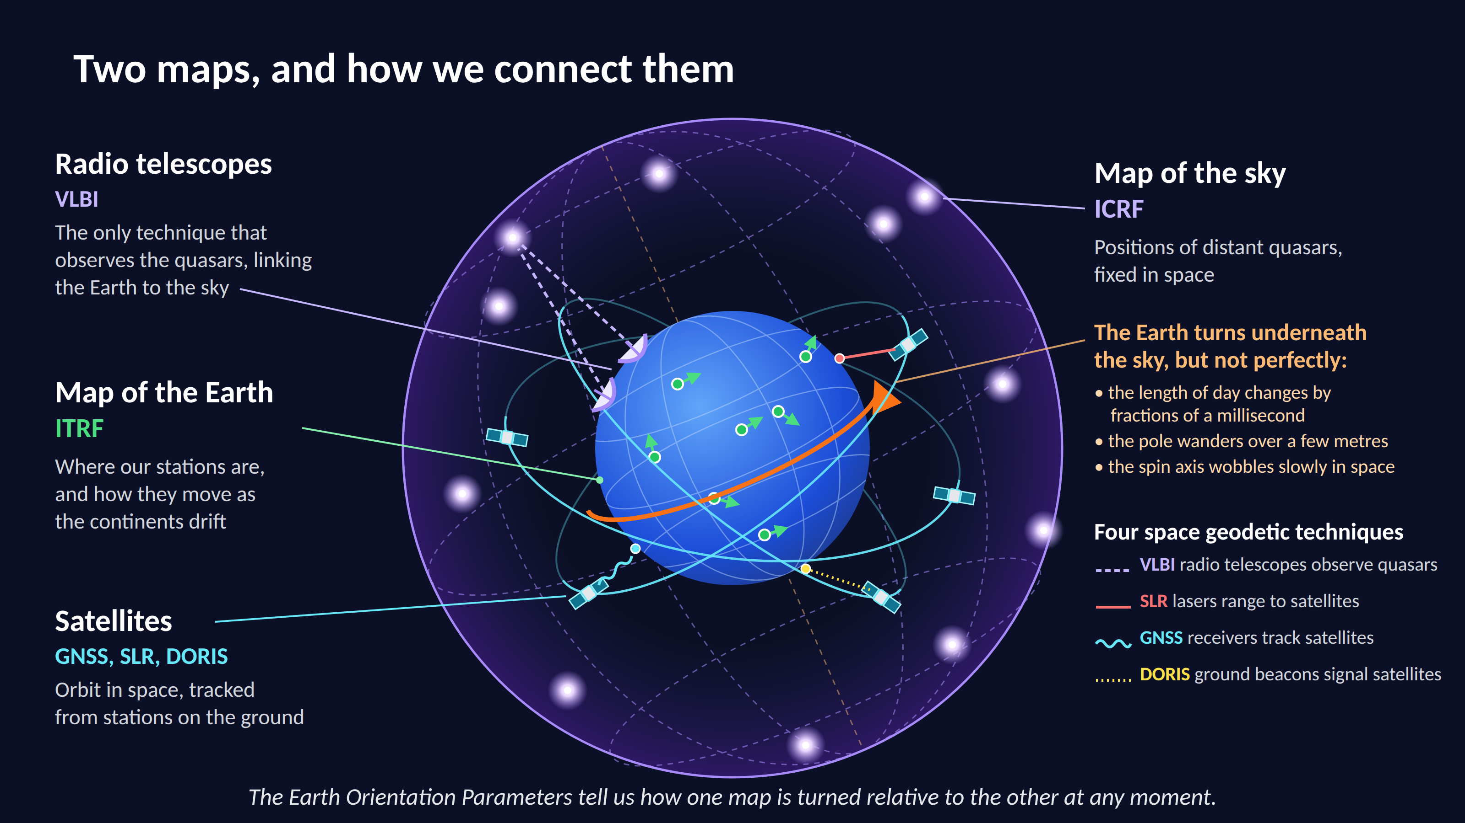
Overview of the 2025 Workshop
Notes:
Standard content layout. Delete the panel if you need full width for the text.

Slide 9
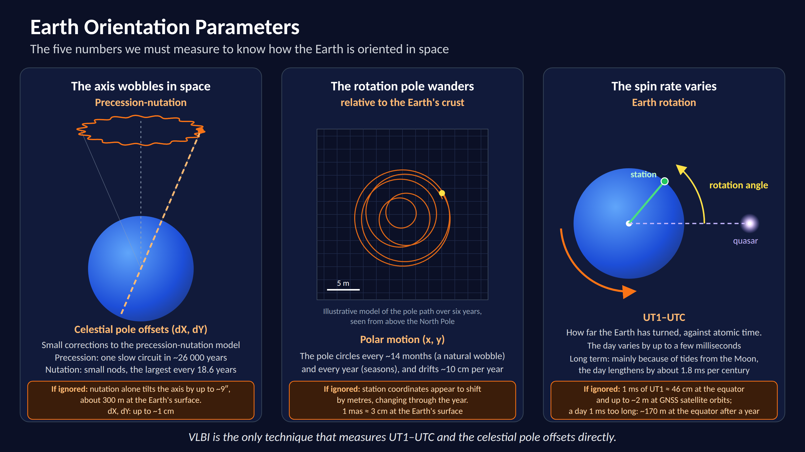
Overview of the 2025 Workshop
Notes:
Standard content layout. Delete the panel if you need full width for the text.

Slide 10
What is Geodesy?
Geodesy is the science of measuring the Earth’s dynamic shape, its gravity field, and its orientation and motion in space
(Space) geodesy
Parameter | VLBI | GNSS | DORIS | SLR
ICRF
Nutation
Polar motion
UT1
Length-of-day
Subdaily ERPs
ERP oceantide amplitudes
Coordinates/velocities (ITRF)
Geocentre
Gravitational field
Satellite orbits
LEO satellite orbits
Ionosphere
Troposphere
Time synchronisation
South African Geodesy Working Group
Notes:
Standard content layout. Delete the panel if you need full width for the text.

Slide 11

How does VLBI work?
VLBI: Very Long Baseline Interferometry using radio telescopes across the to observe quasars
Notes:
Standard content layout. Delete the panel if you need full width for the text.

Slide 12
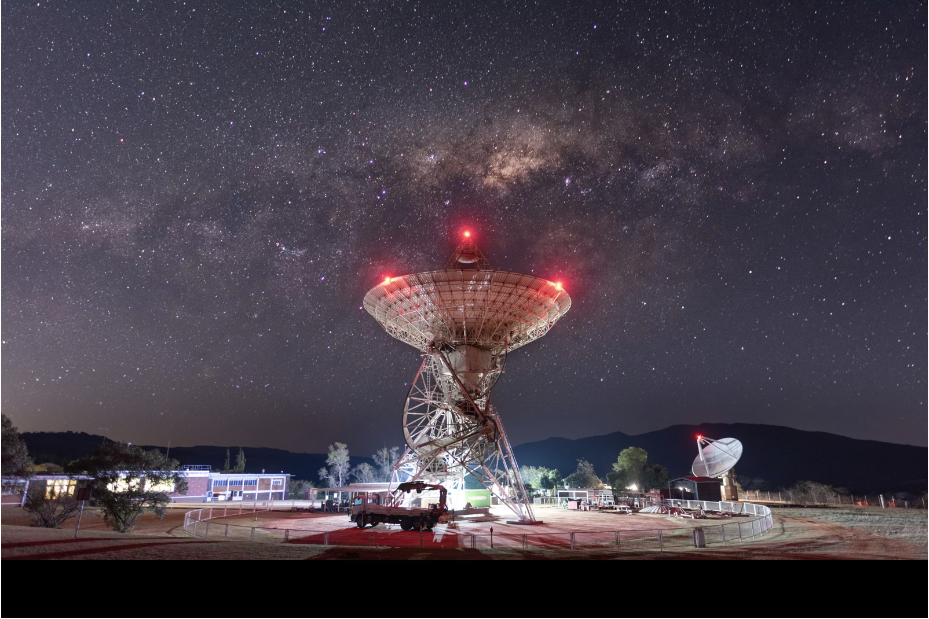
What are Quasars?
AGN: the bright centres of distant galaxies, powered by supermassive black holes. So far away that they show no detectable proper motion.
Notes:
Standard content layout. Delete the panel if you need full width for the text.

Slide 13
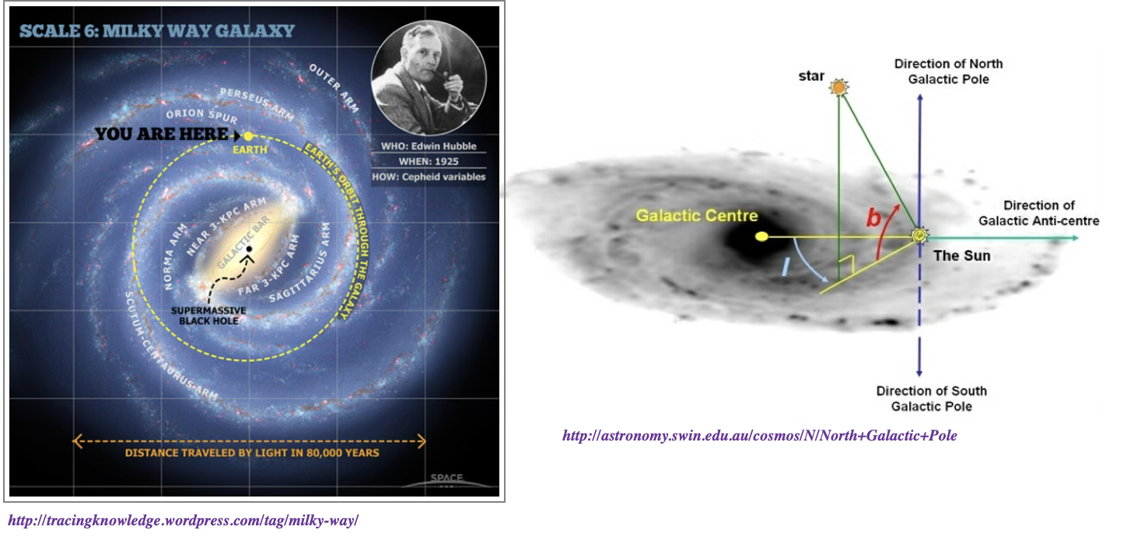
What are Quasars?
AGN: the bright centres of distant galaxies, powered by supermassive black holes. So far away that they show no detectable proper motion.
Notes:
Standard content layout. Delete the panel if you need full width for the text.

Slide 14
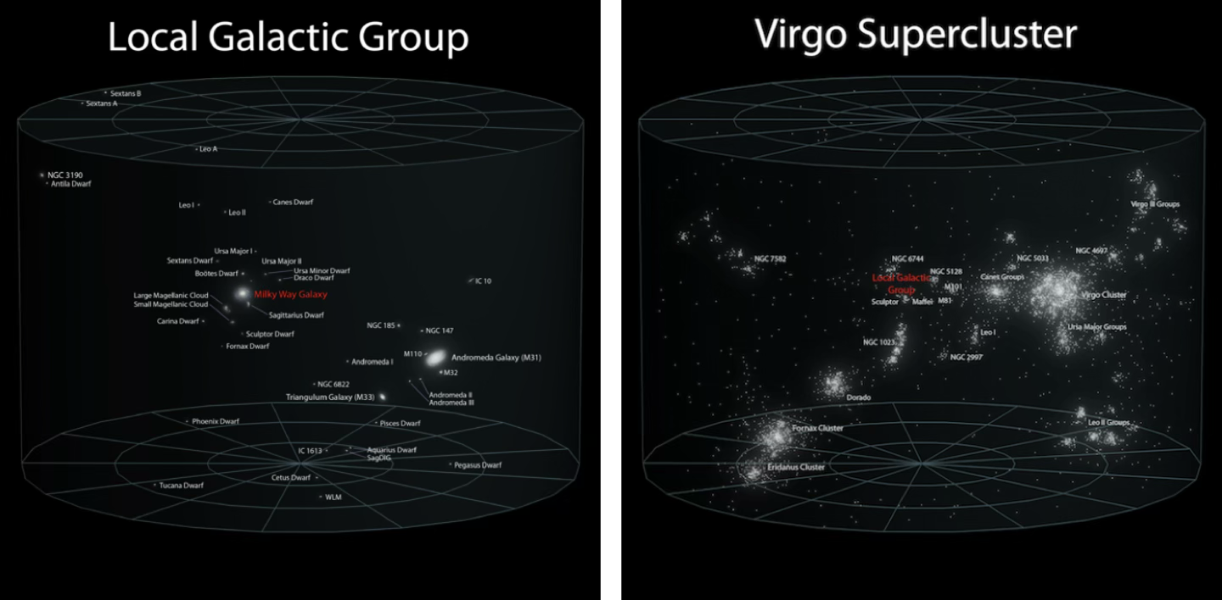
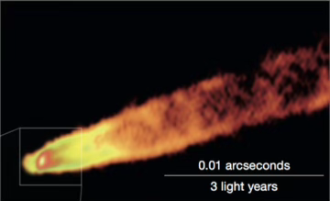
How far before we get to the quasars?
Even larger structures: local group of galaxies, Virgo cluster, Virgo super cluster….
M87, VLBA, 43 GHz
Credit: Andrew Z. Colvin http://commons.wikimedia.org/wiki/File%3AEarth's_Location_in_the_Universe_(JPEG).jpg
Notes:
Standard content layout. Delete the panel if you need full width for the text.

Slide 15
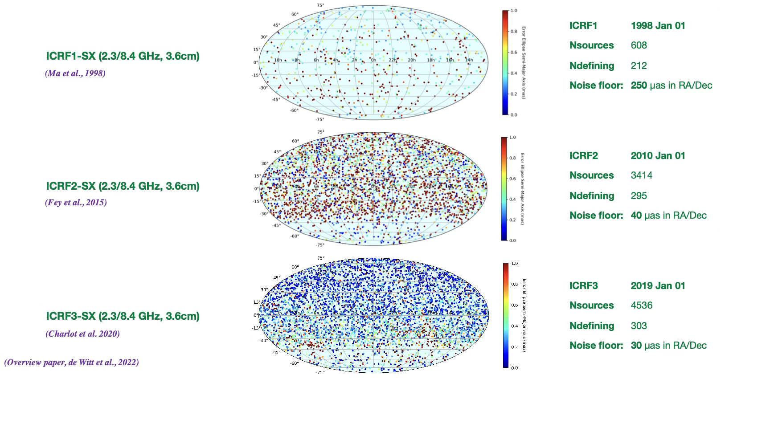
The International Celestial Reference Frame
M87, VLBA, 43 GHz
Notes:
Standard content layout. Delete the panel if you need full width for the text.

Slide 16
The International Celestial Reference Frame
M87, VLBA, 43 GHz
200 µas… about the size of a Euro coin from Korea to South Africa
Notes:
Standard content layout. Delete the panel if you need full width for the text.

Slide 17
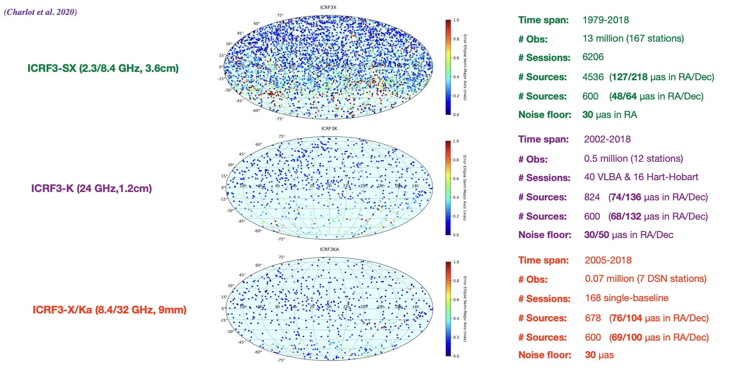
The International Celestial Reference Frame
M87, VLBA, 43 GHz
Notes:
Standard content layout. Delete the panel if you need full width for the text.

Slide 18
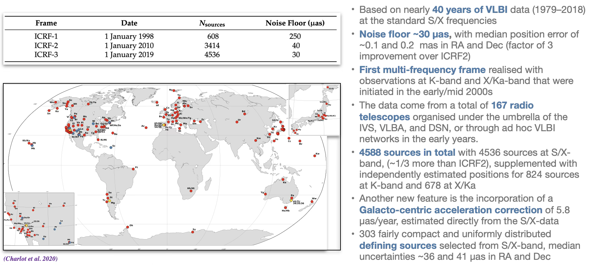
The International Celestial Reference Frame - 3
M87, VLBA, 43 GHz
Notes:
Standard content layout. Delete the panel if you need full width for the text.

Slide 19
The International Celestial Reference Frame - 3
ICRF-4 → coming 2027!!
M87, VLBA, 43 GHz
Notes:
Standard content layout. Delete the panel if you need full width for the text.

Slide 20
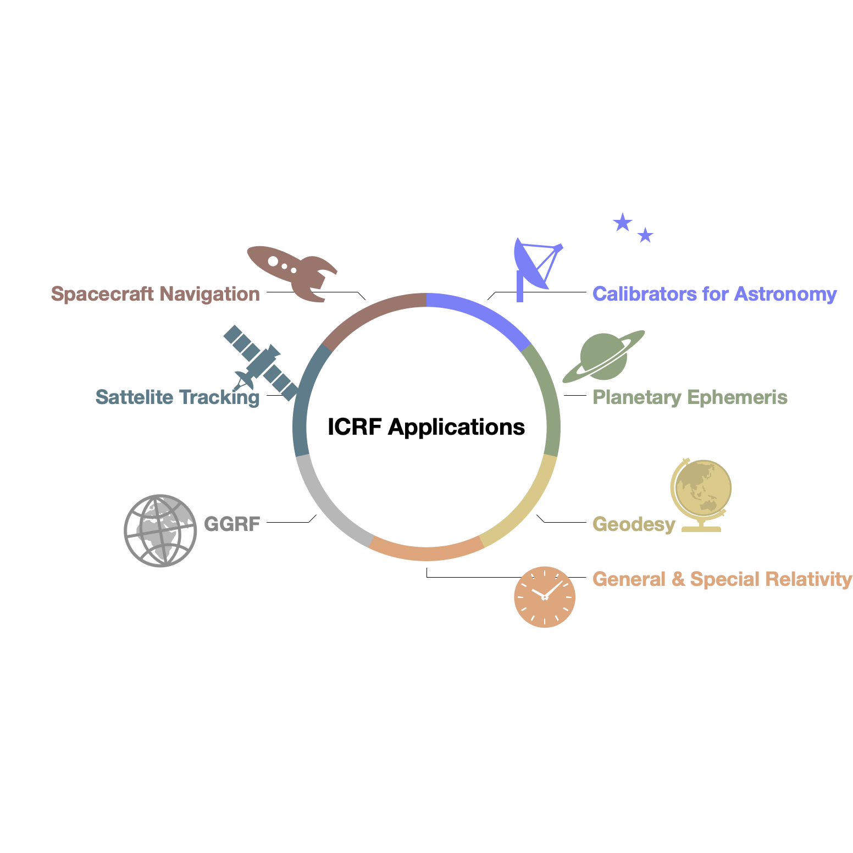
Applications of the ICRF
Notes:
Standard content layout. Delete the panel if you need full width for the text.

Slide 21
Maintenance and continuous improvement of the ICRF requires a substantial investment from many individuals and institutions across the globe. No single person or entity can implement and monitor these programs on their own.
Notes:
Pull-quote or key-message slide. Use sparingly, once or twice in a deck.

Slide 22
Thank you
Aletha de Witt
aletha.dewitt@dsti.gov.za
Notes:
Closing slide with contact details and partner logos.

